Slide 1

Technical Analysis Using Tracking Data & Event Data
Dogan Parlak
Notes:
Hello and welcome, Today I will briefly discuss performing technical analysis using tracking and event data.

Slide 2
Concepts
Ball Location
1) In which third is the ball? (penalty box. final third, midfield third, defensive third)
Press Classification
2) What kind of press is being employed? (press type e.g., direct, indirect)
Running Total of Effective Time
3) Possession (%)
Running Total of Ball Out of Play
4) Ball out of Play (%)
Progression Classification
5) Progression from defensive third to midfield third (% & totals)
6) Unsuccessful progressions from defensive third to midfield third (% & totals)
7) Progression from midfield third to final third (% & totals)
8) Unsuccessful progressions from midfield third to final third (% & totals)
Pass Classification
9) Straight passes
10) Diagonal passes
Notes:
There were ten distinct concepts requested for analysis of this project. I have grouped them into topics based on their content.
These topics are:
Ball location
Press classification
Running total of effective time
Running total of ball out of play
Progress classification
And Pass classification

Slide 3
Data
Event Data:
Records of events that took place in the match.
For each event (record) it basically provides the information about:
Type of the event (e.g., pass, shot)
Team involved
Players involved (e.g., sender and receiver of a pass event)
Spatial location of start and end locations
Tracking Data:
Consists of several snapshots, often referred to as frames, taken throughout the match.
Frame: Observation (snapshot) at a specific moment in the game with a sampling rate 25 fps (frames per second). It includes the possession information and spatial locations of players and the ball at a specific moment.
Notes:
Before talking about them, I would like to briefly talk about the used data.
To start with the event data, it provides the records of all events that took place in the match.
For each event, it basically provides the information about the type of the event, team and players involved, spatial location of start and end locations.
On the other hand, the tracking data consists of several snapshots, often referred to as frames, taken throughout the match.
A frame is defined as an observation at a specific moment in the game with a certain sampling rate which is 25 frames per second in our case.
It includes the possession information and spatial locations of players and the ball at a specific moment.

Slide 4
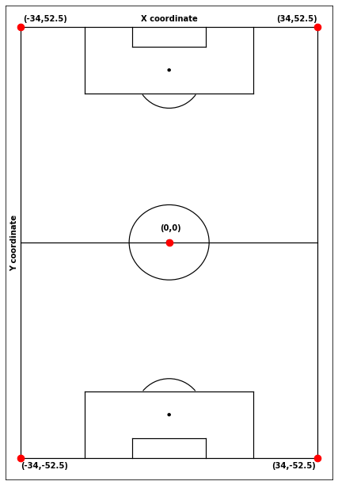
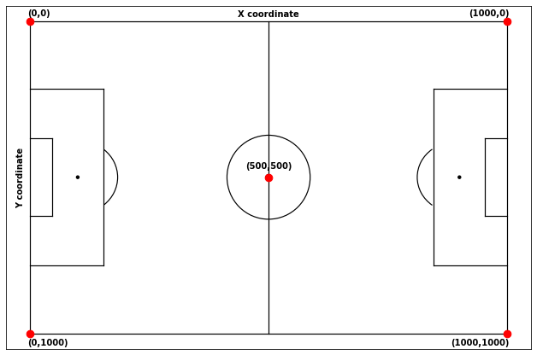
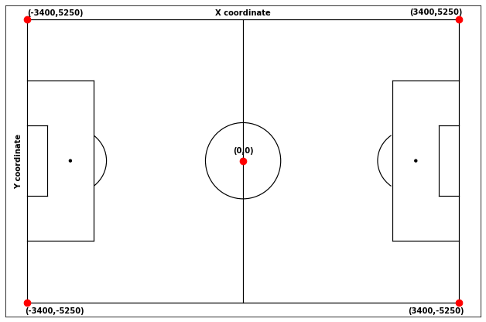
Data
Conversion from event data and tracking data coordinate systems to a vertical coordinate system which aligns with real pitch dimensions
Event Data
Tracking Data
Notes:
One important aspect to handle and to establish a common standard is the coordinate system that is used for the analysis.
First two coordinate systems belong to event data and tracking data respectively.
They are both horizontally aligned with different ranges in both X and Y coordinates.
In order to interpret them in real pitch dimensions, which is sixty eight meters in width and a hundred and five meters in length,
and to preserve the consistency, I have converted both of the coordinate systems to a vertical one as you can see on the right.

Slide 5
Parser Class
A class to fetch general match information and technical information from tracking data.
Technical information:
Ball status (alive or dead)
UTC (time stamp)
Half information
Possession information (home or away)
Throughout the match
Only when the ball is alive
Player and ball coordinates (to vertical coordinate system)
Throughout the match
Only when the ball is alive
Mirrored versions (only when the ball is alive)
Notes:
After completing the data section, I would like to mention the parser class used to process the tracking data.
For the course of this analysis, it is designed to parse a dataframe, however it can be adapted to parse an .xml file as well.
It includes match information and technical information.
For the implementation of the analysis, technical information is more crucial.
After applying some feature engineering the following key elements are utilized in the implementations:
1) The ball status indicating whether the game is in play or not.
2) UTC value, serving as a timestamp, showing the exact time when the frame was observed.
3) Half information indicating which half of the game was the frame observed.
4) Possession information providing the team in-possession. Which is stored for both throughout the match and only when the game is in play.
5) Player and ball coordinates, converted to vertical coordinate system.
They are stored for throughout the match, only when the ball is alive and finally with their mirrored versions,
which means the direction of play for both teams are adjusted to be the same.

Slide 6
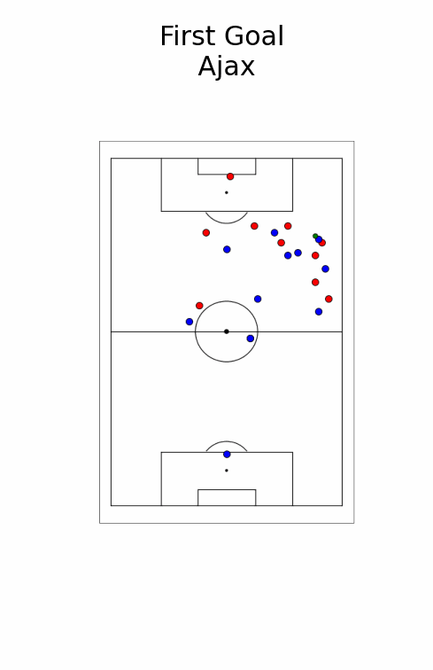
Analyzed Match
LOSC (0) - Ajax AMSTERDAM (2)
27 November 2019
Notes:
While analyzing the data, I discovered that the match provided was Lille against Ajax played in the group stage of UEFA champions league.
On the right hand side, I put an animation showing the first goal of Ajax. The goal was scored at the 2nd minute of the game by Hakim Ziyech who is currently a player of Galatasaray.
The red dots represent the home team which is Lille, the blue dots represent the away team which is Ajax. And the green dot is the ball.

Slide 7
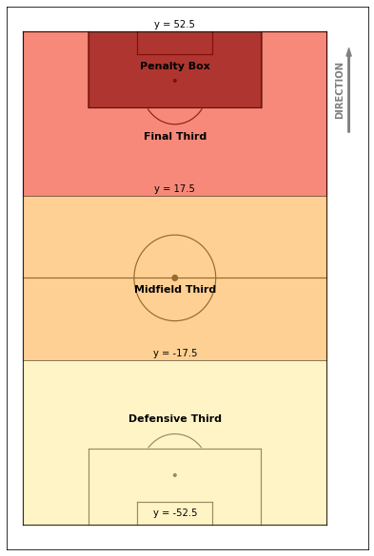
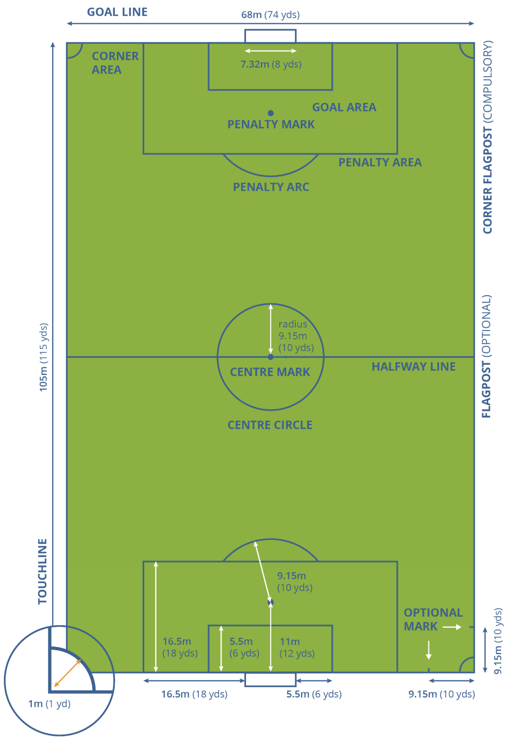
Ball Location
Use mirrored spatial location of the ball according to one of the two teams to determine the direction of play and, consequently, the ball’s location.
Frame-Level analysis.
Notes:
The first concept to be analyzed is ball locations.
After determining a single direction of play using appropriate mirrored locations,
the spatial location of the ball is examined at each ball alive frame and classified correspondingly.
The pitch dimensions played a crucial role to determine the exact zone where the ball is.
As you can see on the right image, the ball can be either in the defensive third, midfield third, final third or in penalty box.

Slide 8
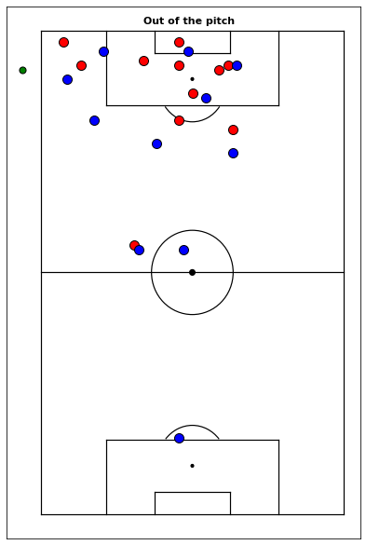
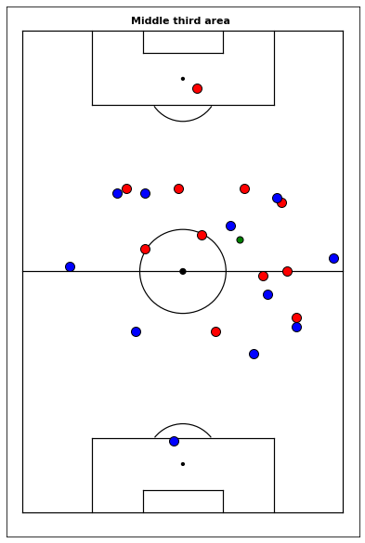
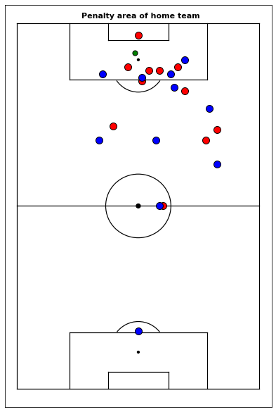
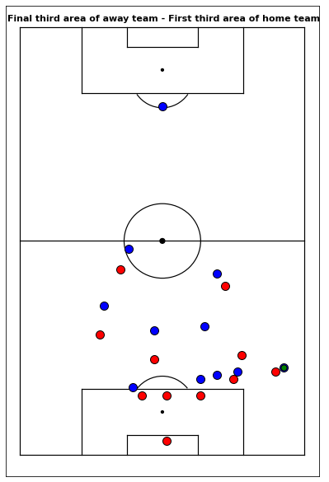
Ball Location
Red dots: Home team
Blue dots: Away team
Green dot: Ball
Notes:
Here are some of the outputs obtained from the classification.
The ball is highlighed with orange rectangle in each image.
Starting from the left, the ball can be out of the pitch, in the middle third, in the penalty area of a team,
and finally in the final third area of a team which means in the first third area of the opponent.

Slide 9
Press Classification
Frame-Level Analysis
Direct Pressure:
Defensive action of a player, reducing the distance between themselves and the opponent in-possession of the ball.
The defending player applies aggressive pressure on an opponent who has possession of the ball.
Indirect Pressure:
Defending players position themselves to block passing lanes, cut off the ball carrier's options, and apply pressure without committing to a full-on tackle or interception.
No Pressure:
If no player is in control of the ball (within 3 meters distance to the ball).
Neither Direct nor Indirect pressure applies.
Notes:
The next concept is pressure classification which is also analyzed in frame-level.
In a frame, there can be either a direct pressure, indirect pressure, or no pressure.
In direct pressure, the key elements to focus are the distances and angles between the attacker, defender and the ball.
Whereas in the indirect pressure, the focus is more on the passing lanes.
If neither condition applies or if no player is in control of the ball, then it is assumed that there is no pressure.

Slide 10
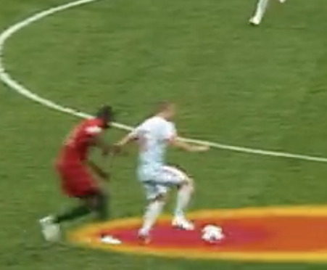
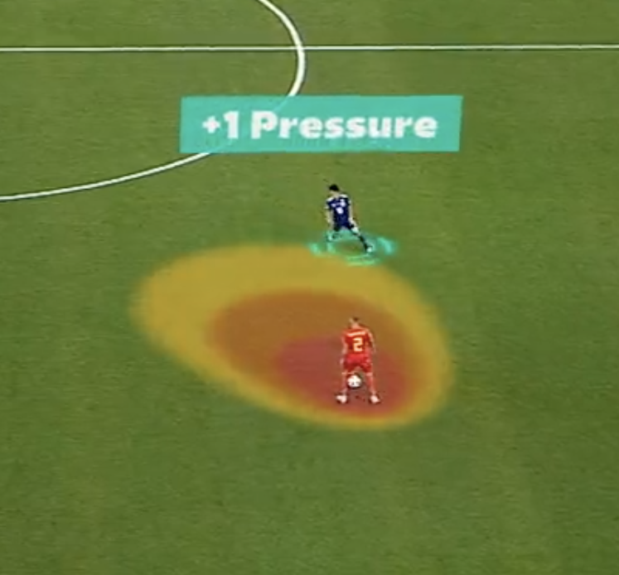
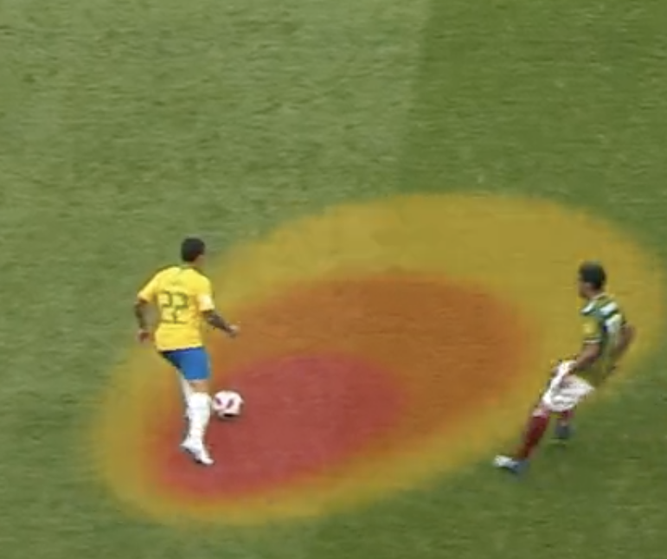
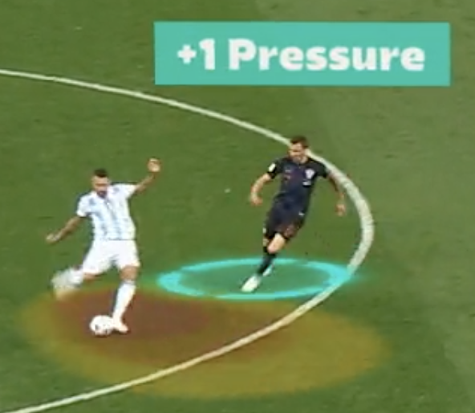
Pressure Classification
4)
1)
Direct Pressure
Examine the geometrical relationship between the attacker (A), defender (D), and the ball (B).
Key factors to include:
Edge (AD)
Edge (AB)
Angle (𝜽) between the edges AD and AB
Distance (d) between D and B
There are four cases that classify a frame as pressure presence:
0° ≤ 𝜽 ≤ 30° and 𝒅 ≤ 3 𝑚𝑒𝑡𝑒𝑟𝑠
30° ≤ 𝜽 ≤ 60° and 𝒅 ≤ 2.5 𝑚𝑒𝑡𝑒𝑟𝑠
60° ≤ 𝜽 ≤ 90° and 𝒅 ≤ 2 𝑚𝑒𝑡𝑒𝑟𝑠
90° ≤ 𝜽 and 𝒅 ≤ 1 𝑚𝑒𝑡𝑒𝑟𝑠
Notes:
The detection of direct pressure involves the geometrical relationship between the attacker, defender and the ball.
On the right-hand side, you will find pressure images from FIFA's website related to the pressure on the ball concept.
Ignoring the distinct colors and treating them equally, direct pressure is assumed to exist within the ellipse-like shape in each image.
The aim of the developed algorithm is to approximate this shape computationally.
For this purpose, the edges between the attacker and defender, the attacker and the ball, the angle between them, the distance between the defender and the ball are introduced.
As the angle between the edges increases, the allowed direct pressure distance decreases.
Similarly, as the angle between the edges decreases, the allowed direct pressure distance increases.
For the obvious cases, if you look at the image indexed with 1 on the top right, you will see that the angle between the edges: attacker and the defender,
and the attacker and the ball is small, hence the allowed direct pressure is within a comparably large distance.
On the other hand, for the image indexed with 4 on the top left, you will see that the angle between those edges is almost one hundred and eighty degrees.
Which conversely allows a minimal distance to account for direct pressure.

Slide 11
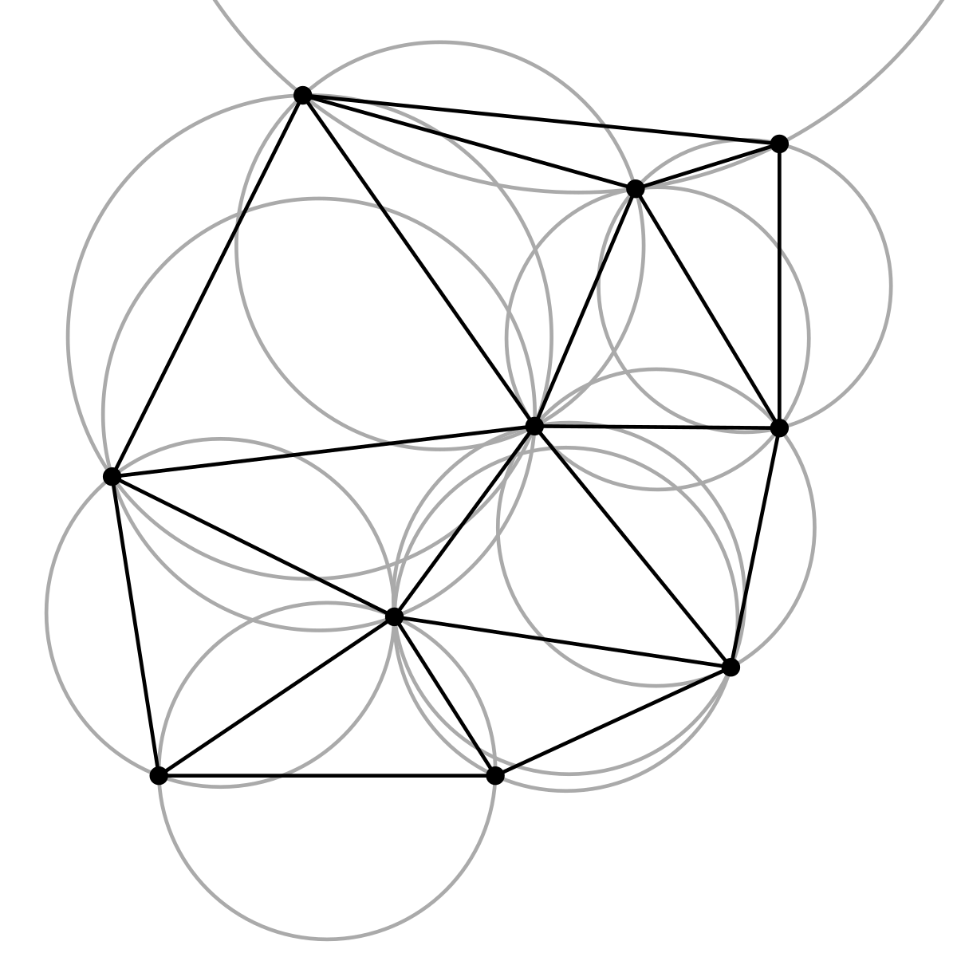
Pressure Classification
Indirect Pressure
Construct the Delanuay Triangulation of the points representing the team in-possession.
Delaunay Triangulation connects points with triangles, maximizing triangle quality and ensuring no points are inside a triangle's circumcircle.
The edges constructed between players represent the passing lanes.
Determine the neighboring players hence the passing options of the Attacker.
Check if there is an opponent within a 2 meters perpendicular distance to the passing lane.
Notes:
On the other hand, indirect pressure focuses on passing lanes which are created by considering the delanuay triangulation of the points representing the team in-possession at that frame.
The delanuay triangulation basically maximizes triangle quality and ensures that no points are inside a triangle’s circumcircle.
The edges in the triangulation represents the passing lanes.
The approach determines the neighboring players hence the passing options of the attacker.
If there is an opponent within a two meters perpendicular distance to the passing lane, then there assumed to be a indirect pressure.

Slide 12
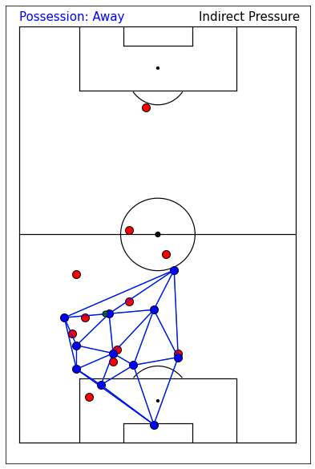
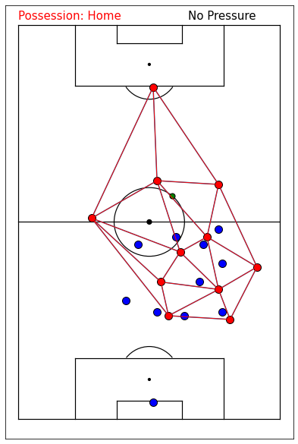
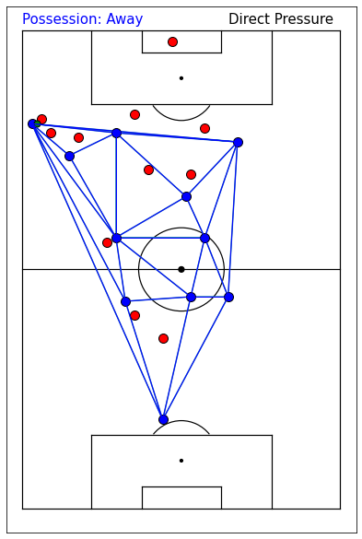
Pressure Classification
Red dots: Home team
Blue dots: Away team
Green dot: Ball
Notes:
Here, you can see the distinct outputs of the algorithm.
In each output you will see the delanuay triangulations formed for the team in-possession which represents the passing options of the players.
On the left image, as you can see there are two red team players marked with orange rectangele, blocking the passing lanes of the attacker.
Hence, indirect pressure is occuring.
In the middle image, there is no pressure on the ball by the opponent team.
On the right, the defending player on top left marked with orange rectangele, applies a direct pressure to the ball.

Slide 13
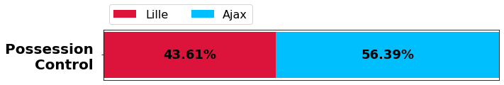
Running Total of Effective Time
Utilizing the available possession information which is either home or away, the running total of effective time is distributed to establish possession % of each team.
For the F^{th} ball alive frame, the possession distribution obtained in the interval [0, F] is computed and assigned accordingly to that frame.
According to logic of the analysis, the last frame’s possesion distribution represents the possession distribution throughout the match.
Notes:
The next concept to investigate is the running total of effective time.
It basically uses the possession information when the ball is alive and assigns the running total of possession distiribution to each frame.
For the F^{th} ball alive frame, the possession distribution obtained in the interval 0 to F is computed and assigned accordingly to that frame.
According to this logic, the possession percentage for the entire match is derived from the possession distribution in the last frame.
It is calculated as forty-three-point six percent for Lille and fifty-six-point three percent for ajax.

Slide 14
Running Total of Ball Out of Play
The frames for the match start, half-time start, half-time end, and match end are established using the possession and half information.
Status of the ball within the first half and second half are filtered.
Employing the available ball status indicating whether a ball is alive (1) or dead (0), running total of ball out of play is obtained.
According to logic of the analysis, the last frame’s calculation represents the ball out of play % throughout the match which is 39%.
Considering that there were 2 minutes stoppage time added to half time and 3 minutes added to the end of game, ball was not alive for 37 minutes.
95 (total) = 58 (alive) + 37 (dead)
Notes:
Furthermore, the running total of the ball out-of-play metric uses
the frames for the match start, half-time start, half-time end, and match end which are established using the possession and half information.
Firstly, the status of the ball within the first half and second half are filtered.
Employing the available ball status indicating whether a ball is alive or dead, running total of ball out of play is obtained.
Similar to the possession distribution, the last frame's calculation represents the overall output, which is the ball out-of-play percentage for the entire match.
It is computed as thirty nine percent.
This corresponds to thirty-seven minutes, accounting for stoppage time added in both halves. Which also means that the ball was alive for only fifty-eight minutes.

Slide 15
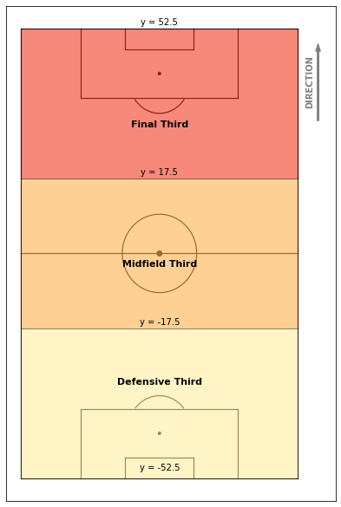
Progression Classification
Successful and unsuccessful progressions from
Defensive Third to Midfield Third
Midfield Third to Final Third
A progression can take place via:
Dribbling (Ball carrying)
Passing
Notes:
Moving forward to the next topic, progression classification considers the successful and unsuccessful progressions from
1) Defensive third to middle third
2) and from middle third to final third
Note that a progression can take place via dribbling or passing.

Slide 16
Progression Classification
Use possession information and mirrored spatial location of the ball to detect the team and progression zone.
After progression between zones, ensure that the team has the possession within 60 frames.
Besides dribbling, progressions can also occur through passing. Ensure that after 10 frames of the zone progression and before 60 frames, the progressing team has ball control, defined as the ball being within 3 meters of a player.
Notes:
The algorithm employs the possession information and mirrored spatial location of the ball to detect the team and progression zone.
It ensures that the progressing team kept the possession of the ball after progression between zones within a sixty frames interval.
As mentioned before, besides dribbling, the progressions can also occur through passing.
Therefore, the ball control needs to be ensured. For this purpose it is ensured that there is actually a receiver in control of the ball within a certain interval after progression.
For this purpose after ten frames of the zone progression and before sixty frames, a player from the progressing team needs to be within three meters of the ball.

Slide 17
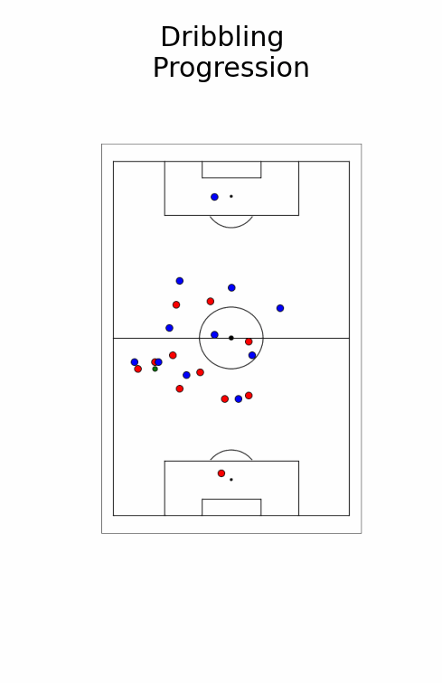
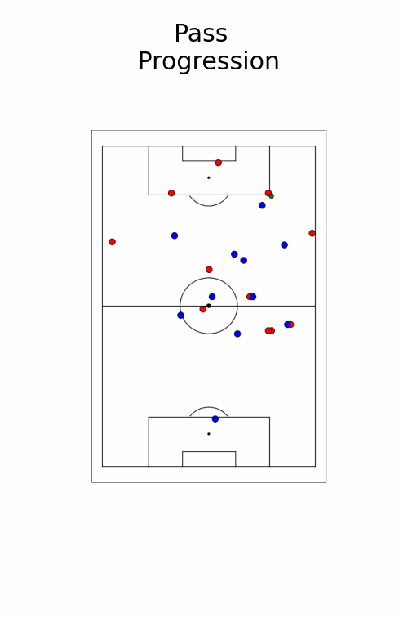
Progression Classification
Notes:
Here are two animations representing the progressions from middle third to final third via dribbling and from first third to second third via passing.
In the first animation blue team progresses whereas in the second animation red team progresses.

Slide 18
Progression Classification
Defensive Third to Midfield Third | #Successful progressions | #Unsuccessful progressions | Success rate (%)
Lille | 45 | 37 | 55%
Ajax | 62 | 40 | 61%
Midfield Third to Final Third | #Successful progressions | #Unsuccessful progressions | Success rate (%)
Lille | 35 | 44 | 44%
Ajax | 44 | 40 | 52%
Notes:
Here are the numerical results obtained after analyzing the entire match.
The upper table includes the stats obtained for progressions from defensive third to midfield third.
Whereas the table below includes the stats obtained for progressions from midfield third to final third.
The counts of progressions and success rates indicate that the success rate decreases as the teams approach their opponents' goals, which is an expected outcome.
Besides defeating the Lille at the end of the match, Ajax also showed a dominance in the progression statistics.

Slide 19
Pass Classification
Diagonal Passes:
Kick or move the ball diagonally across the field.
Change the direction of the ball's movement.
Can be short or long.
Straight Passes:
Characterized by their simplicity and efficiency.
Typically, short and precise.
Other Passes:
Neither classified as diagonal nor straight.
Notes:
The last concept to be analyzed is pass classification.
There are two categories for classifying passes which are diagonal and straight passes.
Diagonal passes are meant to change the direction of the ball’s movement and they can be short or long.
On the other hand, straight passes are characterized by their simplicity and efficiency. They tend to be short and precise.
The ones that require further specification are categorized as "other.”

Slide 20
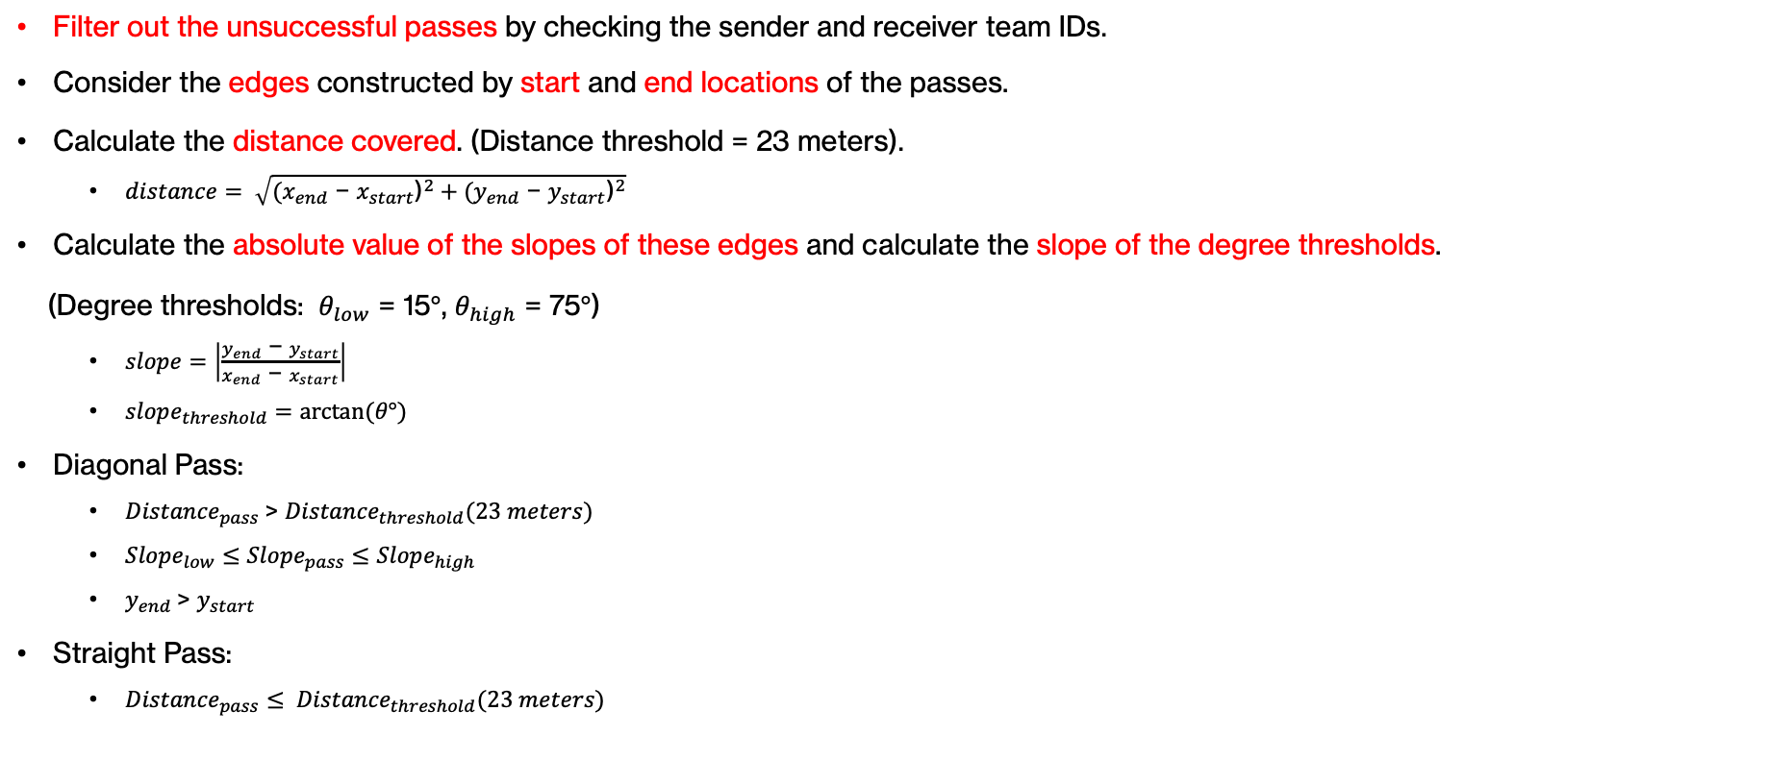
Pass Classification
Filter out the unsuccessful passes by checking the sender and receiver team IDs.
Consider the edges constructed by start and end locations of the passes.
Calculate the distance covered. (Distance threshold = 23 meters).
$distance= \sqrt{{{(x}_{end}\text{ − }x_{start}\text{)}}^{2}+{{(y}_{end}\text{ − }y_{start}\text{)}}^{2}}$
Calculate the absolute value of the slopes of these edges and calculate the slope of the degree thresholds.
(Degree thresholds: $θ_{low}$ = 15$°$, $θ_{high}$ = 75$°$)
$slope=\left|\frac{y_{end}\text{ − }y_{start}}{x_{end}\text{ − }x_{start}}\right|$
$slope_{threshold}=arctan⁡(θ°)$
Diagonal Pass:
${Distance}_{pass}$> ${Distance}_{threshold}(23 meters)$
${Slope}_{low}≤{Slope}_{pass}≤{Slope}_{high}$
$y_{end}$> $y_{start}$
Straight Pass:
${Distance}_{pass}≤ {Distance}_{threshold}(23 meters)$
Notes:
For the analysis, only successful passes are considered.
Edges are formed using the start and end locations of these passes.
The analysis involves calculating the distance covered, the absolute value of edge slopes, and the slope of the degree thresholds.
In the case of diagonal passes, the ball should move forward, the edges should have slopes within a certain interval and they should cover a certain distance.
Conversly, for straight passes, the distance covered should be below a certain threshold.
If none of these applies than the passes are classified as other.

Slide 21
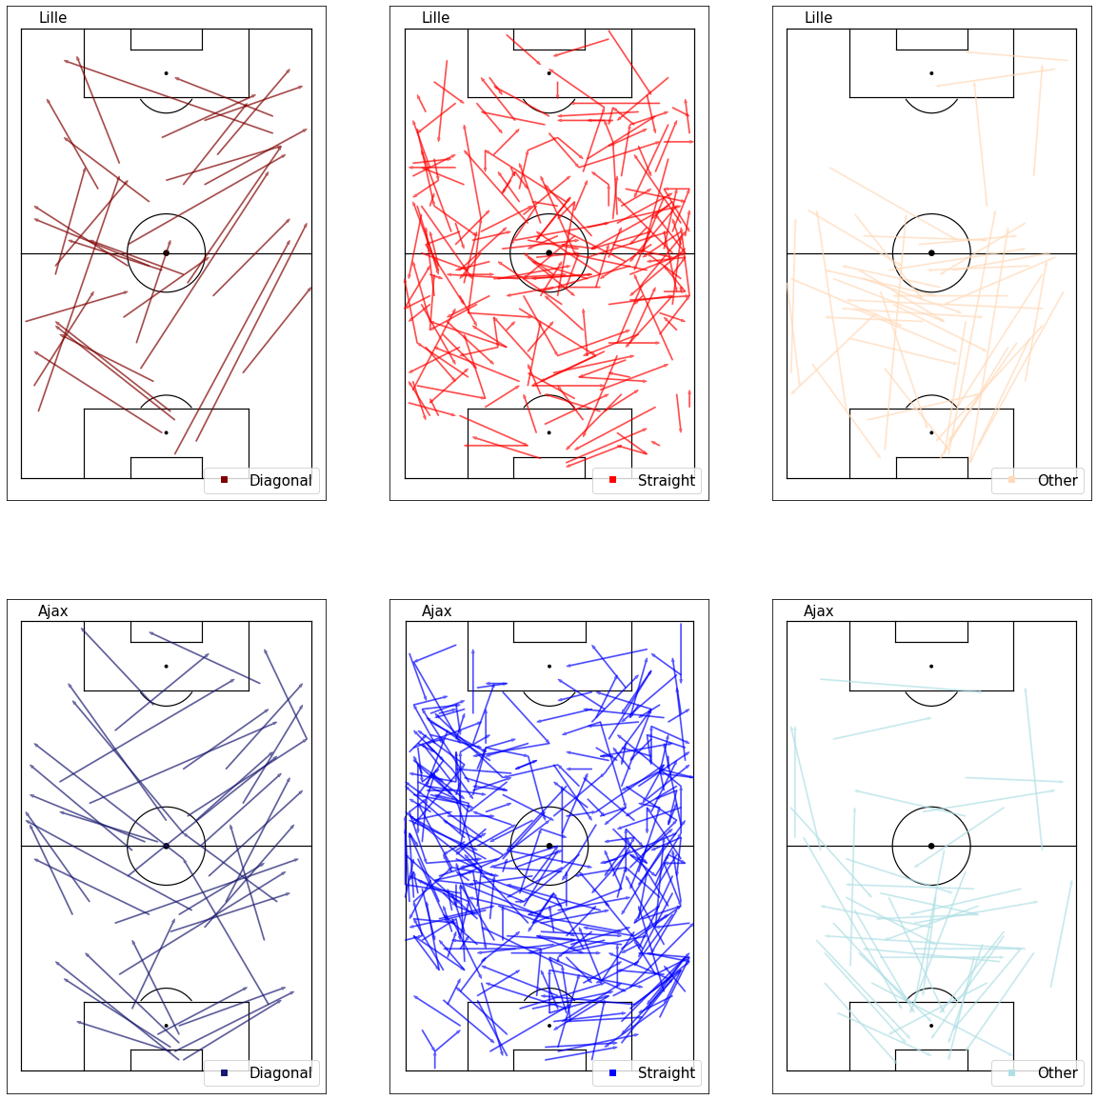
Pass Classification
Notes:
Here are the plots illustrating the successful passes completed by both teams together with their respective classifications.
One can observe that diagonal passes are the ones changing the direction of play and travelling certain distances while keeping a diagonal alignment.
On the other side, the straight passes are short in distance and occurred more frequently in various directions as expected.
The ones classified as other, require more specification of the definitions to establish an accurate classification.

Slide 22
Limitations & Future Work
Synchronization of event data and tracking data.
Provided event data lacks UTC value of the recorded events.
Precisely detecting events (e.g., passes) in the tracking data allows more efficient analysis.
Clear and precise defintions of the concepts would enhance the stability and accuracy of the resuts.
Determination of paramters significantly affects the metric outputs.
Notes:
For the limitations and future work section,
Adding a timestamp to event data would enable synchronization with tracking data, enhancing analysis efficiency, especially in pass detection.
It would allow precisely detecting and labeling frames in the tracking data with the corresponding events.
Finally,
Standardizing concepts and parameters would increase stability and accuracy. For this purpose, determination of the parameters plays a significant role.

Slide 23
Conclusion
In this project, the implementation of several concepts were established using the tracking data and event data.
Ball location - tracking data
Press classification - tracking data
Running total of effective time - tracking data
Running total of ball out of play - tracking data
Progress classification - tracking data
Pass classification - event data
The data and its processing steps, the implementation of the concepts and their respective outputs are explained in technical level and demonstrated with visuals and animations.
Encountered limitations and potential future works were highlighted.
Notes:
To conclude, the analysis of the concepts:
Ball location
Press classification
Running total of effective time
Running total of ball out of play
Progress classification
And Pass classification.
were established using the tracking data and event data.
The data and its processing steps, the implementation of the concepts and their respective outputs are explained in technical level and demonstrated with visuals and animations.
Encountered limitations and potential future works were highlighted.

Slide 24
Q&A
Thank you for listening!
Notes:
I would like to thank you for listening to me and looking forward to your questions.

